Slide 1
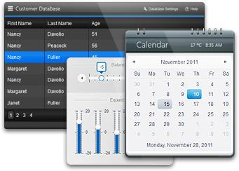


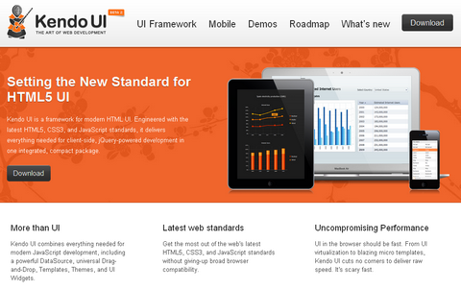
Kendo UI Overview
What it is, and does it work
Telerik School Academy
Learning & Development
http://academy.telerik.com

Slide 2

Table of Contents
Installation
DataSource
Templates
Validator
UI Widgets
Bonus – Server Side Wrappers and Mobile

Slide 3

Installation
Getting ready for Kendo UI

Slide 4

Installation
First include the style sheets
kendo.common.min.css (common css first)
kendo.{theme}.min.css (theme css)
Then include the JavaScript files
jquery.min.js (jQuery is needed first)
kendo.web.min.js (Kendo Ui web)
Enable intellisence
kendo.web.min.intellisense.js in scripts folder

Slide 5
Installing Kendo UI
Live Demo

Slide 6

DataSource
Data, data, data

Slide 7

DataSource
Abstraction over local or remote data
Play central role in Kendo UI applications
Retrieve data from local or remote end point
Provides CRUD operations and serialization
Provides filtering, grouping, page sizing
Synchronizing updates (batch and normal)
And many more

Slide 8

DataSource
Initialization with new kendo.data.DataSource
Takes an JSON object as parameter
The JSON object contains variable options
data option – array of same objects or string
var cars = [
{ make: 'Opel', model: 'Insignia' , year: '2009'},
{ make: 'Audi', model: 'A5', year: '2008'},
{ make: 'BMW', model: 'M3', year: '2010'},
{ make: 'Mercedes', model: 'CL', year: '2011'}
];
var carsDataSource = new kendo.data.DataSource({
data: cars
});

Slide 9

DataSource
columns option – array of objects
field, width, title
aggregate option – array of objects
field, aggregate
"average", "count", "max", "min", "sum"
…
columns: [
{ field: 'make', width: 50, title: 'Make' },
{ field: 'model', width: 50, title: 'Model' }
],
aggregate: [
{ field: 'power', aggregate: 'sum' },]
…

Slide 10

DataSource
filter option – array of objects
logic option: ‘and’, ‘or’
filters option: array of objects
field, operator, value
operators: "eq", "neq", "lt", "lte", "gt", "gte"
…
filter: {
logic: 'and',
filters: [
{ field: 'make', operator: 'eq', value: 'Audi' },
{ field: 'year', operator: 'gt', value: 2006 }
]
}
…

Slide 11

DataSource
group option – array of objects
field, dir, aggregates
dir: ‘asc’ and ‘desc’
…
group: {
field: 'make',
dir: 'desc',
aggregates: [
{ field: 'power', aggregate: 'max' },
{ field: 'make', aggregate: 'count' }
]
}
…

Slide 12

DataSource
sort option – array of objects
field, dir
dir: ‘asc’ and ‘desc’
…
sort: {[
{ field: 'year', dir: 'desc' },
{ field: 'make', dir: 'asc' }
]}
…

Slide 13

DataSource
transport option – array of objects
create, read, update, destroy
url, dataType
parameterMap – function for parsing data
…
transport: {
read: {
url: 'http://someurl.com/api/read',
dataType: 'json'
},
…

Slide 14

DataSource
batch option – boolean
page option – number
pageSize option – number
serverPaging option – boolean
serverSorting option - boolean
events – change, error, sync
…
change: function (e) {
…
}
…

Slide 15

DataSource
Methods
add – object or Kendo.data.model
aggregate – get or set configuration
aggregates – returns result
at – indexator
data – gets or sets the data array
fetch – reads the data, needs ready function
filter – gets or sets the configuration
group – gets or sets the configuration
indexOf – return the index of an object in data

Slide 16
DataSource
Methods
insert – inserts data at specified index
page – gets or sets the current page
pageSize – gets or sets the page size
read – reads the data
remove – removes item
sort – gets or sets the configuration
sync – syncs data with remote service
total – number of items in data
view – return corresponding data (with fetch)

Slide 17
DataSource
Live Demo

Slide 18

Templates
Mustache, Beard, Eyebrows

Slide 19
Templates
Kendo UI templates – in script tags
Type of tag – “text/x-kendo-template”
Should have id attribute
Initialized with kendo.template($('#id').html())
Takes object parameter with data
Appended to other DOM (jQuery) elements
<script type="text/x-kendo-template" id="some-id">
// template </script>
var tmpl = kendo.template($('#some-id').html());
$('#some-tag').append(template({ /* data obj */ }));

Slide 20

Templates
Syntax
Normal HTML syntax
# Between number sign you can write JS code
#: Takes a string from a parameter
#= Takes the value from a parameter
<script type="text/x-kendo-template" id="car">
<div>
<span>#: make #, </span>
<a href="/cars/#= id #">#: model #</a>
</div>
</script>
var carTemplate = kendo.template($('#car').html());
$('#some-tag').append(template({
id: i, make: car.make, model: car.model }));

Slide 21
Templates
Live Demo

Slide 22
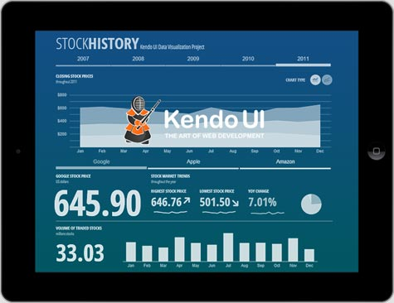
Widgets
The cool stuff!

Slide 23
Widgets
Widgets
Appended to jQuery objects (DOM elements)
May have additional options depending on the widget and the usage of it
$('#menu').kendoMenu();
$('#grid').kendoGrid({
dataSource: carsDataSource,
editable: true,
toolbar: ['create']});

Slide 24
Widgets
Live Demo

Slide 25
Kendo UI Web
http://academy.telerik.com

